Slide 1
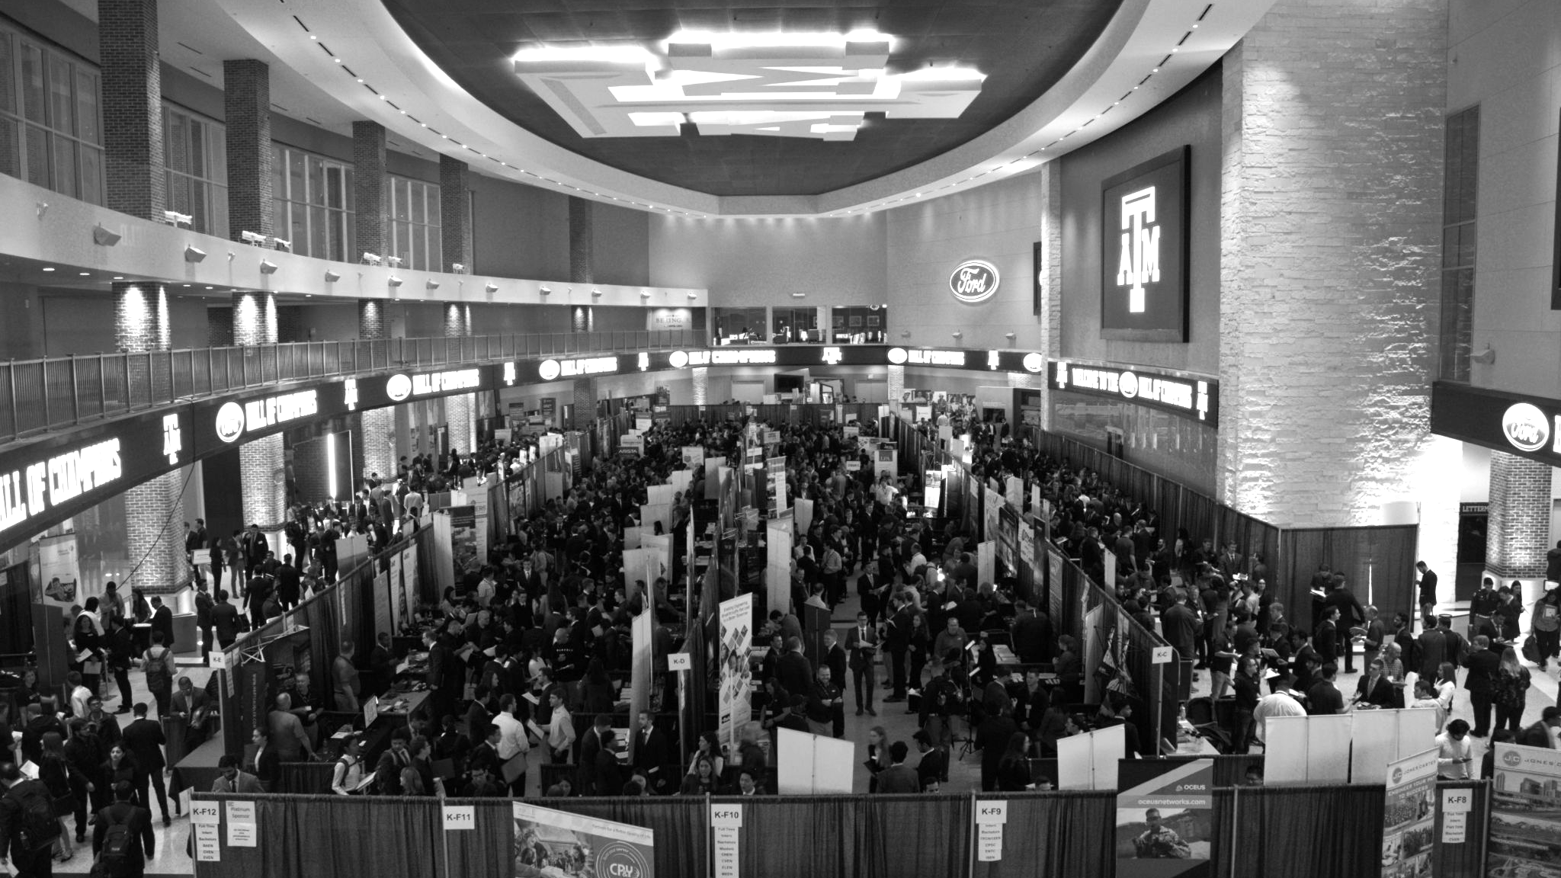

LANL Team Update
10/25/2024
Izzy Baumler, Dalton Boeckmann, Morgan Gullo, Jade Waldron

Slide 2
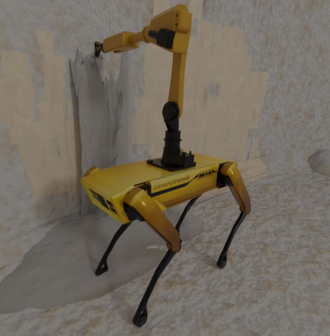
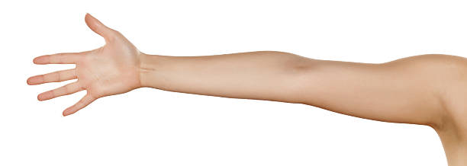
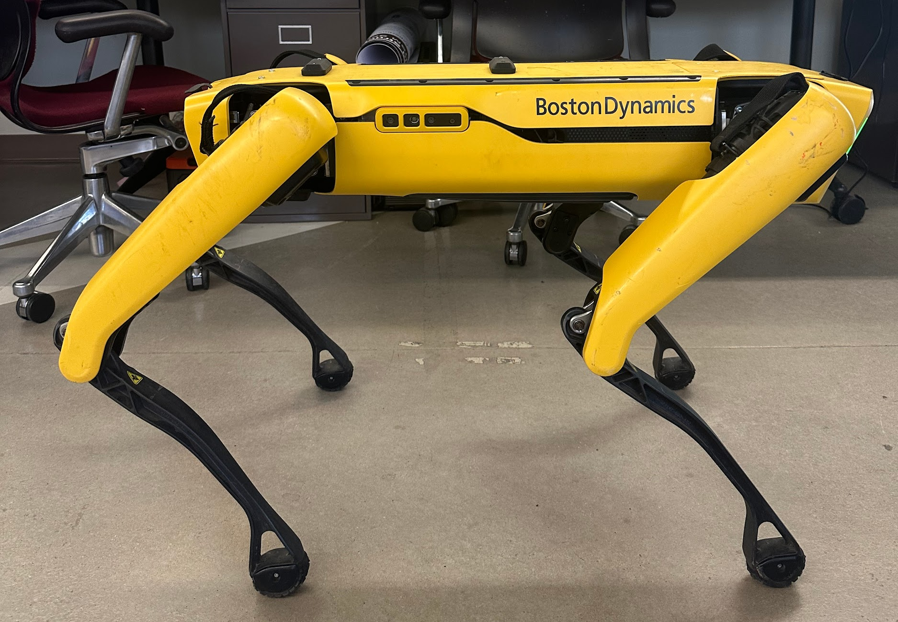
Mission Statement
There is a need for a technology that has 6 DOF and can move through its full range of motion in each degree of freedom up to 1 Hz.

Slide 3
Customer Needs
Customer Interviews - Michael, Rodrigo
Supplemental Design Survey - Link Here
# | Designated Need | Importance Score (1 to 5, 5 = most important)
1 | Highly Maneuverable/Fast | 5
2 | Precise/Accurate Control | 4
3 | Versatile | 4
4 | Durable under harsh conditions | 4
5 | Stable | 4
6 | Lightweight | 3
7 | Semi-Autonomous | 2

Slide 4
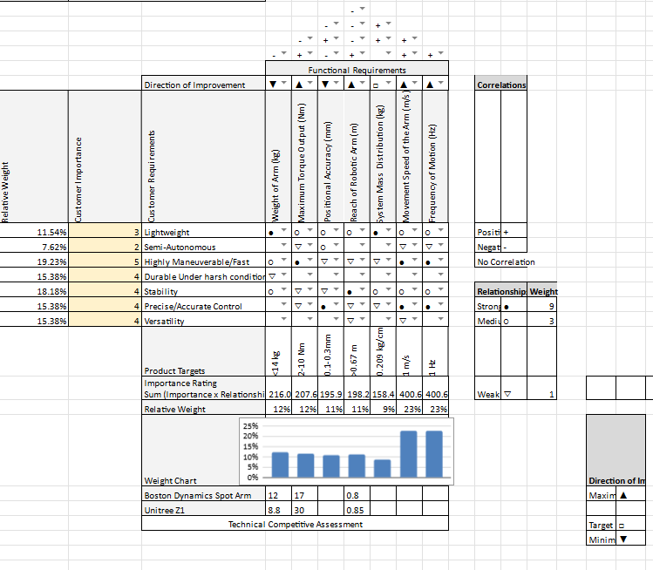
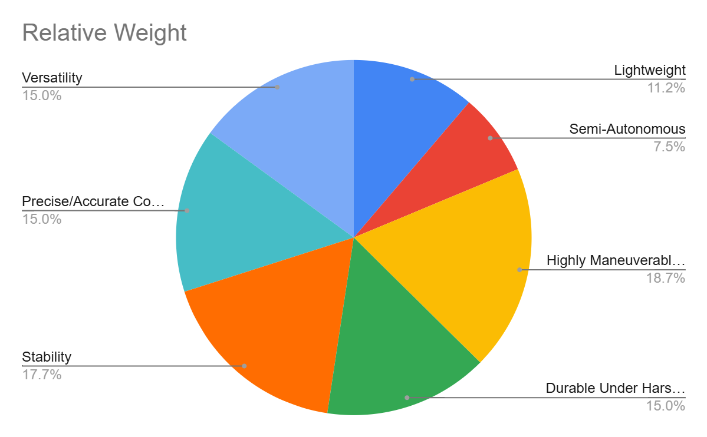
Customer Needs

Slide 5
Design Requirements
Requirement # | Need # | Metric | Importance Score (1 to 5, 5 = most important) | Required Values | Units
1 | 7,5 | Weight of the Arm | 3 | <14 | kg
2 | 1,2,4 | Maximum Torque Output | 3 | 2-10 | Nm
3 | 2,3,8 | Positional Accuracy | 3 | 0.1-0.3 | mm
4 | 2,5 | Reach of Robotic Arm | 3 | >0.67 | m
5 | 3,5,7 | System Mass Distribution | 2 | 0.209 | kg/cm
6 | 1,2 | Movement Speed of the Arm | 5 | 1 | m/s
7 | 1,2,3,5 | Frequency of Motion | 5 | 1 | Hz

Slide 6
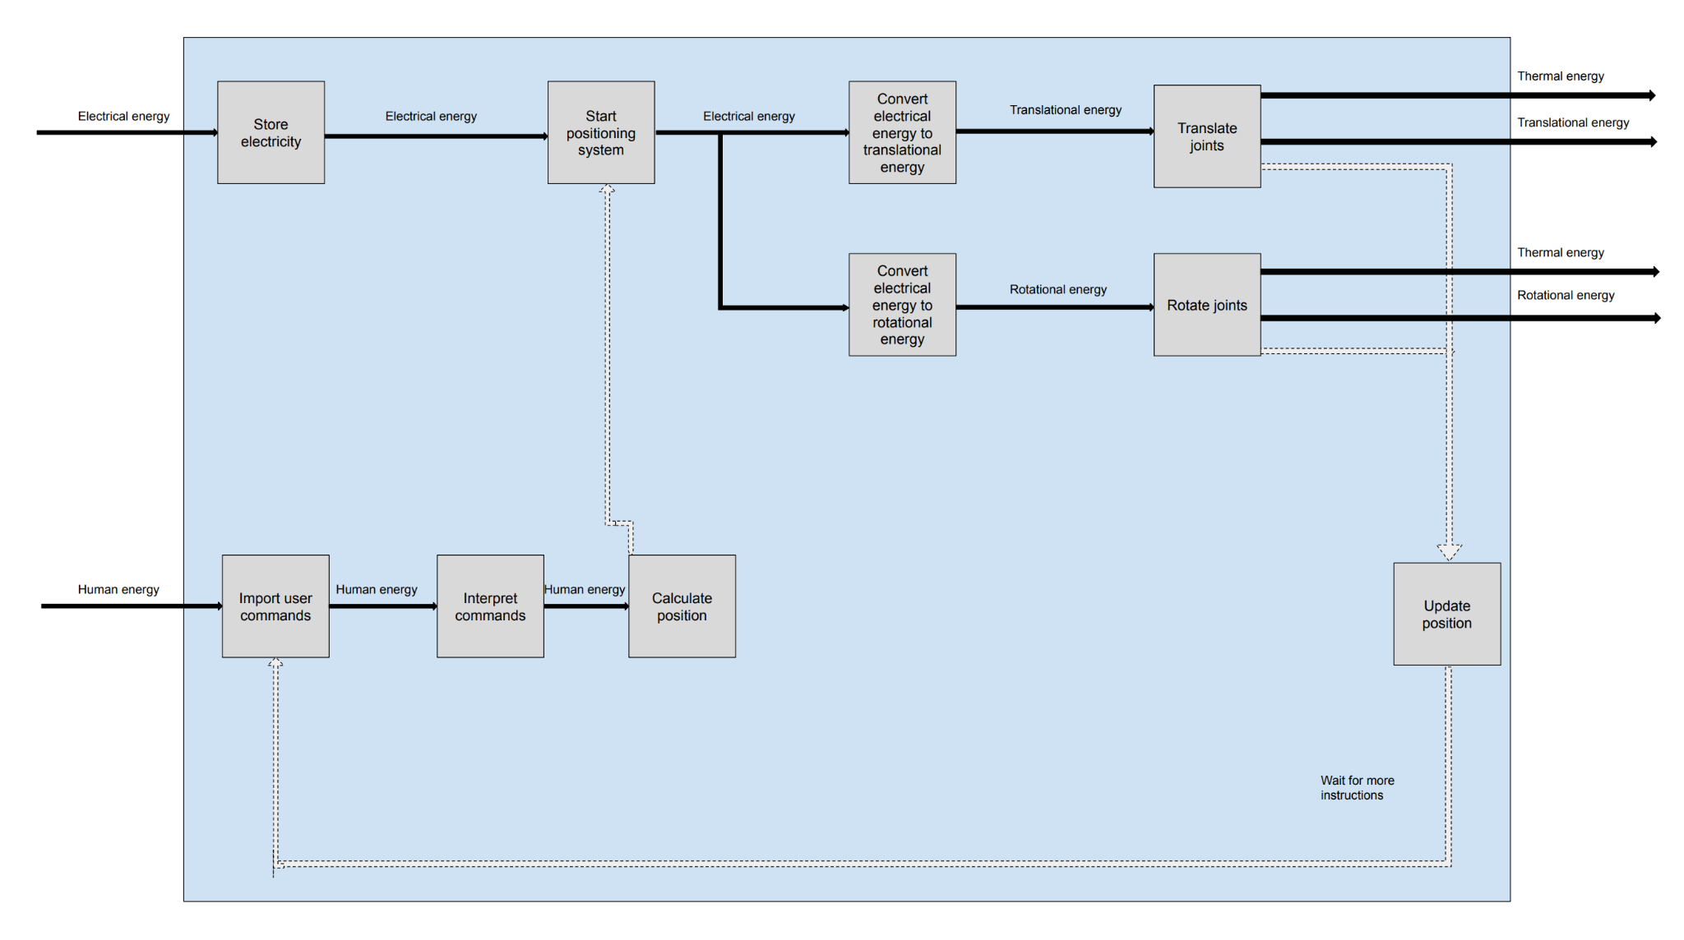
Functional Model
In order to break up a complex problem into simplified subfunctions, our team created a functional model of the robotic arm.

Slide 7
Idea Generation Process
Our lecture course had us explore several idea generation processes order to break up a complicated design into individual components. This allowed up to focus on satisfying each component before combining it into a complex design.
We chose the techniques of:
Brainstorming
Theory of Inventive Problem Solving
Design by Analogy

Slide 8
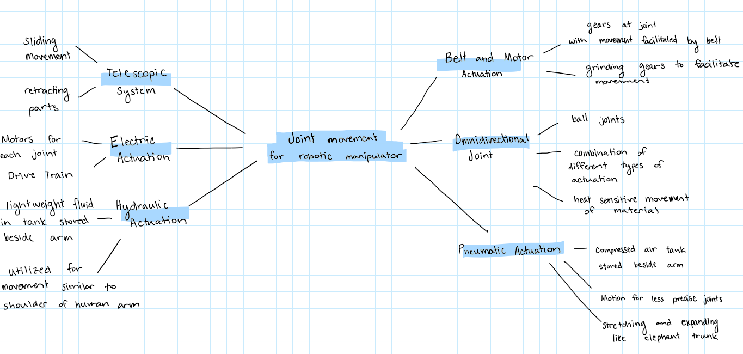
Brainstorming

Slide 9
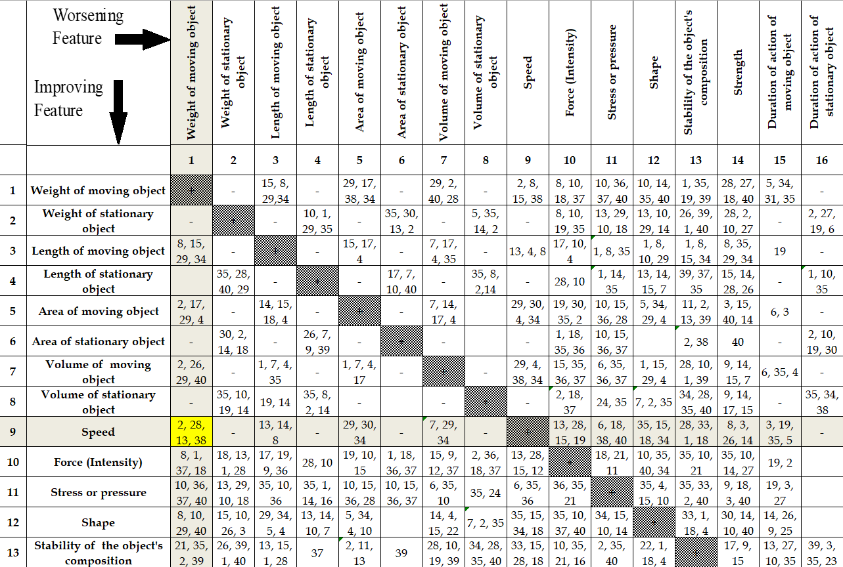
Theory of Inventive Problem Solving (TRIZ)
TRIZ is a structured idea generation method developed by analyzing patterns found in idea patents. This focuses on eliminating trade-offs and conflicts within a system to drive innovation.
Our team chose the following trade offs:
Decreasing the weight while increasing the movement speed of the arm
Decreasing the complexity of the arm while increasing the movement speed of the arm

Slide 10
TRIZ Continued
Principals we utilized:
Mechanics Substitution: encourages the use of electric, magnetic, and electromagnetic fields to control or interact with objects, or the combination of such fields with field-activated particles.
‘The other way round’: focuses on reversing the typical roles of movable and fixed parts within a system
Asymmetry: This principle involves transforming a symmetric design into an asymmetric one to unlock functional advantages.
Ideas: This concept involves generating controlled magnetic fields to manipulate or propel the arm segments without relying on traditional mechanical actuators. Another idea was to heat certain materials within the arm, enabling changes in material properties, such as softening or contracting, which could potentially facilitate smoother or faster movement. Both approaches aim to replace heavy mechanical components with field-based mechanisms, reducing the overall weight while optimizing motion efficiency.
flexible materials at fixed joints, allowing the arm to bend and flex without traditional hinges or actuators
he team conceived ideas such as telescoping translational movement, where the arm could extend or retract in a non-uniform manner, making it adaptable to different operational needs. Another idea focused on fluid dynamics, where the arm’s internal flow could be manipulated to alter its stiffness or length. By adjusting the flow properties or incorporating variable pressure zones, the arm could become more rigid for precise tasks or lengthen to reach distant objects.

Slide 11
Design by Analogy
Design by analogy is an idea generation method that involves drawing inspiration from solutions in other fields or natural systems to solve a design problem. By identifying similarities between the present challenge and analogous situations in unrelated domains, designers can leverage proven principles and approaches to generate innovative concepts.
- Pollard's lab captures detailed videos of how a human hand grasps and manipulates objects
- Robotic hands in Pollard's lab use actuators as artificial tendons to enable movement.
- Alamgir Karim’s lab at the University of Houston uses low-voltage electric fields to control soft polymers that mimic muscle movements.
- Karim’s team has identified triblock copolymers that can operate actuators with as little as a 10-volt battery, offering a low-energy solution for robotic applications.
- Festo's Bionic Handling Assistant emulates human bones and muscles using pneumatic actuators for fluid, coordinated movement (cite this source).
- This robotic arm has a complex structure that allows it to lift loads, move with precision, and securely grip objects.
- The human arm, equipped with 64 muscles, 28 bones, and various sensory receptors, can perform diverse tasks such as throwing a baseball at 150 km/h and lifting up to 250 kg.

Slide 12
Morphological Matrix
Subfunction | Solution
Store Electricity | Rechargeable/ Primary Batteries | Capacitors | Cable connection | Wires | Energy Harvesting
Start positioning system | Wires
Convert electrical energy to translational energy | Motor | Actuator | Gears | Drive Train
Translate joints | Pulleys | Omnidirectional joint | Telescoping system | Actuation | Heat-sensitive movement of material | Magnetic levitation | Compressed air like elephant trunk or hose
Convert electrical energy to rotational energy | Motor | Actuator | Gears | Drive Train
Rotate joints | Pulleys | Ball joint | Combining different actuators | Gimbal Mechanism | Magnetic Couplings
Import user commands | Arduino | Raspberry Pi | Bluetooth | Pre-programmed commands | Voice Recognition | Gesture Recognition
Interpret commands | Python | C++ | MATLAB | Simulink
Calculate position | Inverse Kinematics | Forward Kinematics
Utilizing all research to generate solutions to each sub function and create a final, complex design

Slide 13
4 Concepts
 | Solution
Subfunction | Concept 1 | Concept 2 | Concept 3 | Concept 4
Store Electricity | Batteries | Cable Connection | Batteries | Cable Connection
Start positioning system | Wires | Wires | Wires | Wires
Convert electrical energy to translational energy | Gears and Motors | Actuator | Motor | Actuators and Motors
Translate joints | Pulleys | Telescoping System | Actuation | Telescoping System
Convert electrical energy to rotational energy | Motor | Motor and Actuator | Motor | Motor
Rotate joints | Gimbal Mechanism | Ball Joint | Actuation | Ball Joint
Import user commands | Raspberry Pi | Bluetooth | Raspberry Pi | Raspberry Pi
Interpret commands | Python | C++ | Python | Python
Calculate position | Inverse and Forward Kinematics | Inverse Kinematics | Inverse Kinematics | Inverse Kinematics

Slide 14
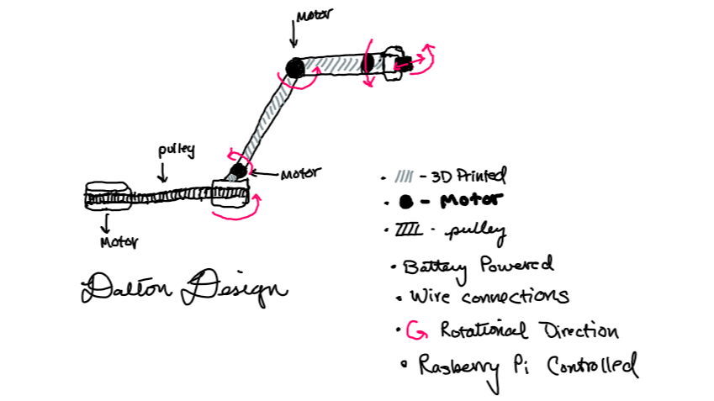
Concept 1

Slide 15
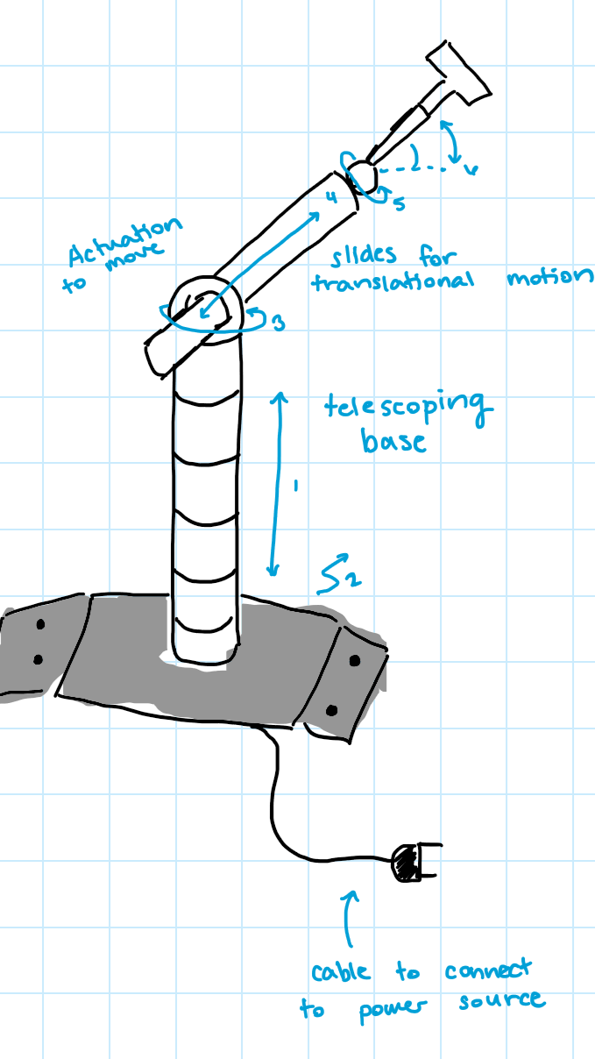
Concept 2
Telescoping Arm through actuation (enables the arm be compact)
Telescoping arm to allow translational movement
6 Degrees of Freedom
6 motors for rotation and translation
Connected with an electrical wire to outlet

Slide 16
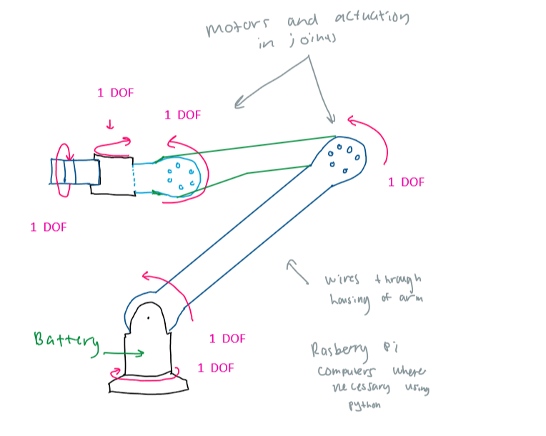
Concept 3

Slide 17
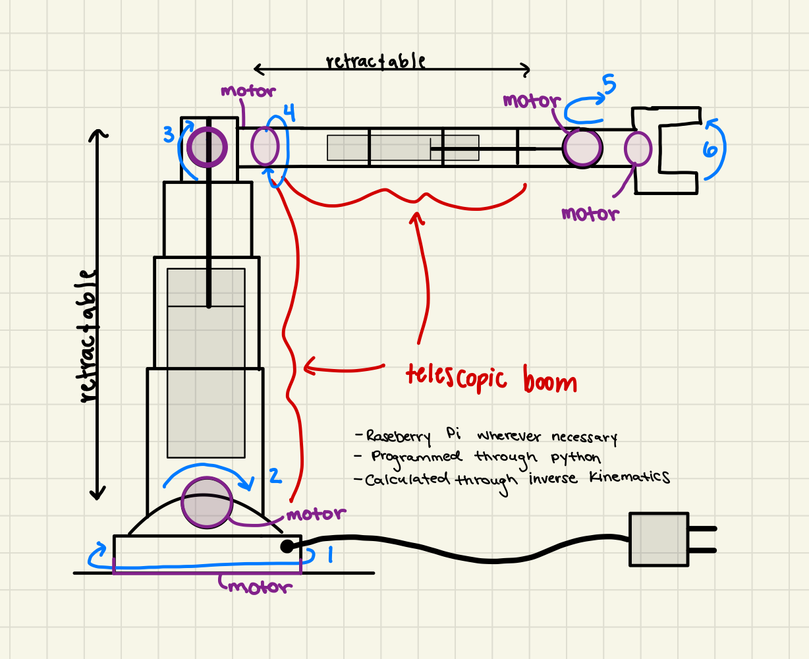
Concept 4
Telescoping Arm through actuation (enables the arm be compact)
6 Degrees of Freedom
6 motors for rotation and translation
Connected with an electrical wire to outlet

Slide 18
Future Work
Start to specify motors, lengths, and materials for each concept and begin comparing them in reference to our customer needs and requirements
Compare through a Pugh chart and an IIAE Matrix
Choose final design and create preliminary CAD model
Begin our Embodiment Design

Slide 19
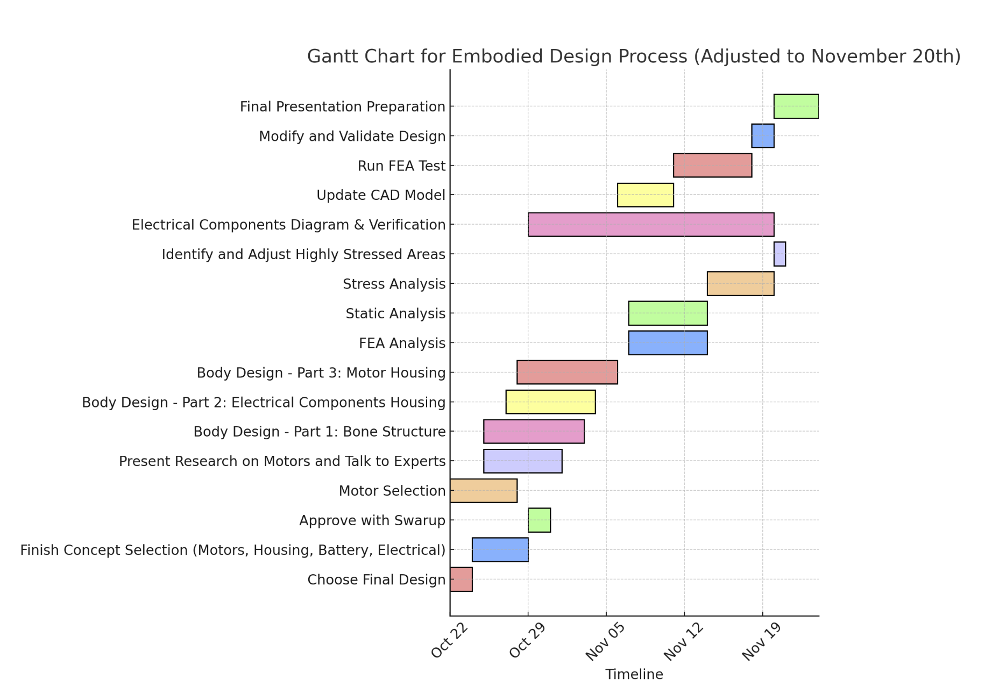
Embodiment Design Plan
Organized detailed solution path for us to follow to meet all deadlines
Specific time to design verification with FEA analysis
Currently in the Process of Finalizing our Design

Slide 20
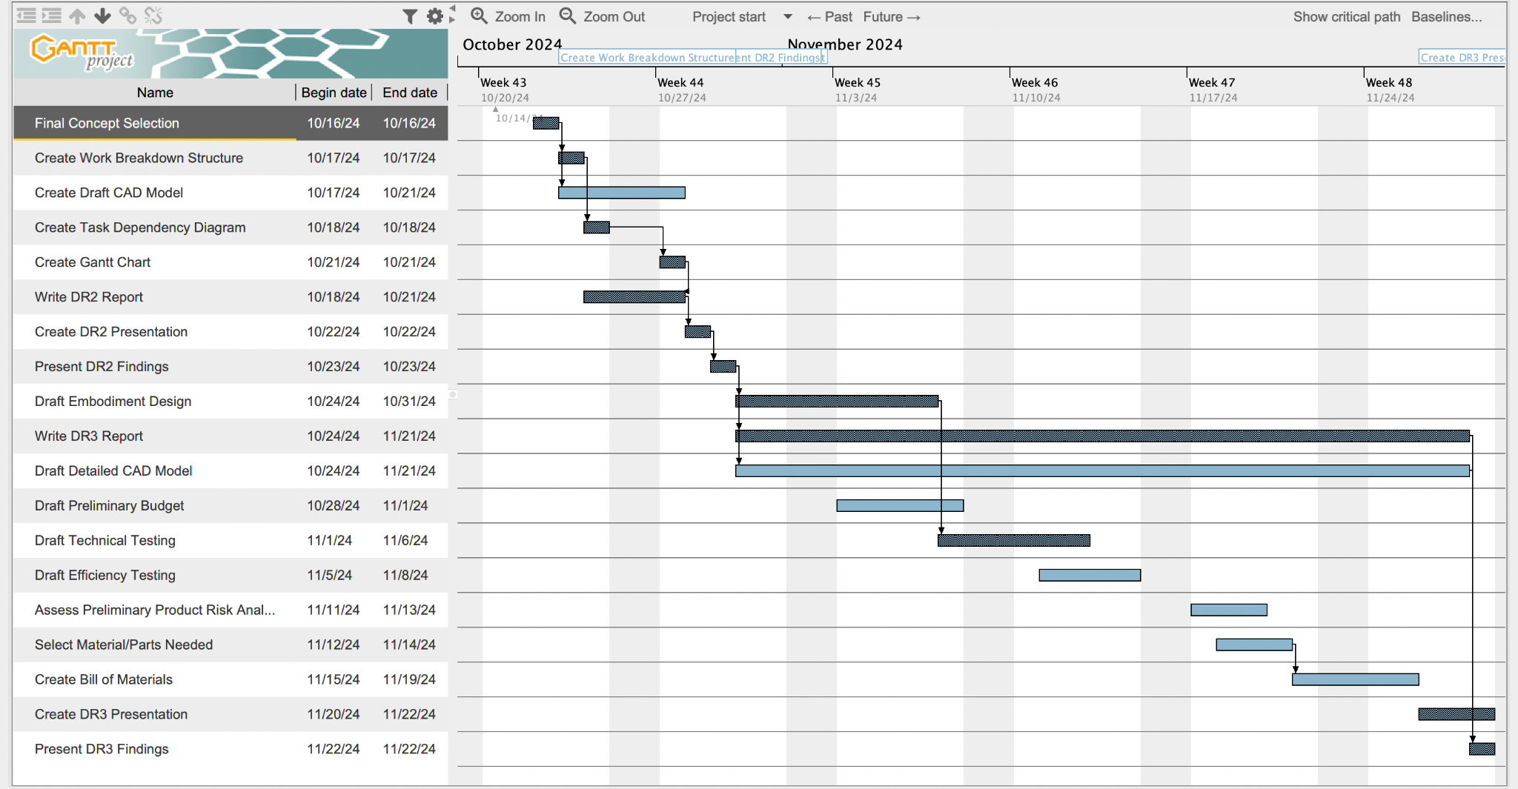
Schedule

